Slide 1
European Platform for Emerging Talents
Creative Europe Platform Project

Slide 2
WHO ARE THE EMERGING TALENTS?
Aged 18-30
Achievements at national level
No international management
willing to participate in an international project,
Able to cooperate with peers coming from different countries

Slide 3
Objectives
Support young talents
to foster the development of emerging talent and stimulate the transnational mobility of cultural and creative players and circulation of works
All art project
Network building (involving institutes and professionals from the creative/cultural sector)

Slide 4
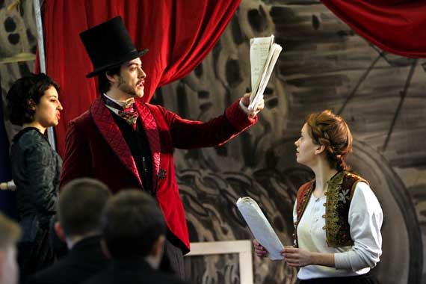
WHO IS ELIGIBLE?
TO BE A PLATFORM MEMBER…..

Slide 5
Eligibility of platform members
The platform's members are companies, associations or organisations active in the cultural and creative sectors whose aim is
to showcase and promote European creators and artists of the non-audiovisual cultural and creative sectors and their works.
To be eligible , the platform's members shall already comply with the set of criteria set out by the coordination entity in the application at the time of the submission and must have showcased at least 30 % of emerging artists as defined by the coordination entity in the previous twelve months. Proof of this compliance will be required in the detailed description of the project.

Slide 6
Coordination entity
The coordination entity is a company, association or organization active in the cultural and creative sectors, fully responsible for the implementation of the project. The coordination entity shall be responsible for the selection and monitoring of the platform's members according to a set of criteria.The coordination entity shall enter into a written agreement with the platform's members defining their respective roles.
The coordination entity has to be capable to represent the members of the platform in any contractual relationship with the Agency that may be concluded if the platform is selected

Slide 7
What is done ?

Slide 8
PREPARATION PROCESS
45 institutes from 24 EU countries
correspondence with 48 colleagues and professionals from universities, cultural institutes and foundations
Contribution of 6 EU talent centres (Slovenia, Italy, Lithuania, Hungary, UK, Ireland)

Slide 9
Potential Platform members
Participating countries: UK, Ireland, France, Italy, The Netherlands, Slovenia, Lithuania, Denmark, Croatia, Poland, Spain
We have NO contact in Belgium, Luxembourg, Sweden, Greece

Slide 10
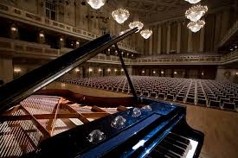
WHO HAVE JOINED?
Cultural Institutes, Universities, NGOs

Slide 11
List of Partners
Danish Talent Academy Denmark
Paris College of Arts France
Royal Irish Academy of Music Ireland
Italian Association for Gifted and Talented Students Italy
National Student Academy Lithuania
Ljubljana University Slovenia
UCAM Universidad Católica San Antonio de Murcia Spain
Glasgow School of Arts UK, Scotland
Stichting Nederlandse Muziek Export (SNME)Foundation of Dutch Music Export (The Netherlands)
Soleart Management Italy
Fundacja Czwarty Wymiar (Fourth Dimension Foundation)Poland

Slide 12
DEADLINES
Call for proposals February 2017
Submission of the proposals will be in 6 April

Slide 13
What happens after a successful application?
Joint activities
Creating of mobile application, finding fellows for joint projects
Arts management workshop
All art performances
Improvization workshop
Exhibitions
Opportunities for emerging talents to be showcased

Slide 14
CONTACT:
balazs.hornyak@gmail.com
www.talentcenterbudapest.eu

